Slide 1


K. RAMAKRISHNAN COLLEGE OF TECHNOLOGY
(AUTONOMOUS), TIRUCHIRAPALLI
AI-BASED DOCUMENT FORGERY DETECTION
A Comparative study of Deep learning
PRESENTED BY,
Team Members Name
BHARATH RAJ R
2503811724321017
BHUVANESHWARI P
2503811724322018
DEEPAK VK
2503811724321019
DEVALAKSHMI V
2503811724322020

Slide 2
OBJECTIVES
• Develop an AI-based system for automated preliminary document verification.
• Accept scanned documents or document images as input.
• Improve document quality using image preprocessing.
• Extract text using Optical Character Recognition (OCR).
• Analyse visual and textual features using a trained ML/DL model.
• Identify possible modifications and suspicious regions.
• Reduce manual verification effort and provide faster screening.

Slide 3
PROBLEM IDENTIFICATION
• Forged documents can contain subtle changes in text, spacing, images or backgrounds.
• Manual checking requires significant time and human effort.
• General image-forgery methods may not work well for structured document images.
• Scanning, compression, resizing and photographing can weaken forensic traces.
• Advanced detection methods may require large datasets and high computational resources.

Slide 4
Flow Diagram
1.Document Upload
2.Image preprocessing
3.OCR / Text Extraction
4.Feature Extraction
5.AI Forgery Detection
6.Original / Modified
7. Suspicious Region

Slide 5
LITERATURE SURVEY - 2023-2026
Literature Survey Reference:
https://1drv.ms/x/c/6764aba1aa88c2bf/IQDW4pMIBzWoQKfei2iH1nMnAU8uxY3FxnXMDsFeKPsMG8Y

Slide 6
RESEARCH METHODOLOGY
1.Data Collection
2.Preprocessing
Collect original document images from authorized sources.
Make all images the same size
Create controlled fake versions by altering text, photos, signatures
Remove noise and improve brightness, contrast, and clarity.
Label images as forged and protect all personal information.
Scale pixel values consistently for better model performance.
3.OCR Processing
OCR scans the document and detects printed or handwritten characters
It converts the text into editable digital data that a computer can read and process.
The extracted text can be checked for names, dates, numbers, and signs of forgery.

Slide 7
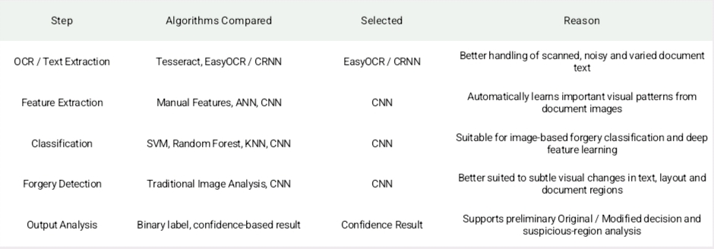
COMPARISON OF ALGORITHMS

Slide 8
IMPLEMENTATION IDEA
Tools:
Python, OpenCV, OCR (Tesseract/EasyOCR), TensorFlow/PyTorch, CNN, and Google Colab/GPU for model training.
Dataset:
Collect authorized original document images and create controlled forged versions by modifying text, photos, signatures, spacing, or backgrounds. Label them as Original and Forged.
Preprocessing:
Resize documents, remove noise, improve brightness and contrast, and normalize pixel values.
OCR:
Extract printed or handwritten text and analyse names, dates, numbers, and other text for inconsistencies.
Feature Extraction:
Extract visual and textual features such as text regions, layout, spacing, image patterns, and OCR-based information.

Slide 9
MODULES
1. Document Upload
  Upload scanned/photographed document image Validate input format and basic image quality
2. Image Preprocessing
  Resizing and normalization Grayscale/contrast enhancement Preparation for OCR and AI analysis
3.OCR & Text Analysis
  Extract text from the document image identify text regions and analyse consistency
4. AI Forgery Detection
  Pass features to the trained ML/DL model Predict likely original or possibly modified
5. Result & Suspicious
Display the final authenticity prediction Provide confidence/result information where supported

Slide 10
CONCLUSION & FUTURE SCOPE
Conclusion:
The proposed AI-based document forgery detection system combines image preprocessing, OCR, feature extraction, and CNN-based classification to identify whether a document is original or possibly modified. It can provide a fast preliminary verification result and highlight suspicious regions when supported.
Future Scope:
Improve accuracy using larger and more diverse document datasets.
Add stronger forgery localization and explainable AI features.
Deploy the system as a secure web or mobile application for real-time document verification.

Slide 11
THANK YOU

